Slide 1
Multiple Files Executing Application
USING PYTHON

Slide 2
IMPORTANCE
Sometimes we need to open particular apps for a specific situation.
For example, suppose someone is doing his/her homework on computer and using apps like MS word, Notepad, Snipping tool, MS teams , or may be Resso.
So, Improving our workflow, we are going to build an app that lets us auto open up a bunch of other apps that we would normally use. You can imagine it as being a workspace opener.

Slide 3
CODE
import tkinter as tk #Tkinter module is imported
from tkinter import filedialog, Text
import os #functions for creating and removing a directory (folder)
root = tk.Tk()
apps = []
def addApp(): #Adds apps/files in the list
for widget in frame.winfo_children():
widget.destroy()
filename=filedialog.askopenfilename(initialdir="/", title="Select File",
filetypes=(("executable", "*.exe"), ("all files", "*.*")))
apps.append(filename)
print(filename)
for app in apps:
lable = tk.Label(frame, text=app, bg="gray")
lable.pack()
def runApps(): #Executes the provided apps/files
for app in apps:
os.startfile(app)

Slide 4
if os.path.isfile('save.txt'):
with open('save.txt', 'r') as f:
tempApps = f.read()
tempApps = tempApps.split(',')
apps = [x for x in tempApps if x.strip()]
canvas = tk.Canvas(root, height=500, width=700, bg="#263D42")
canvas.pack()
frame = tk.Frame(root, bg="white")
frame.place(relwidth=0.8, relheight=0.8, relx=0.1, rely=0.1)
openFile = tk.Button(root, text="Open File", padx=10, pady=5, fg="white", bg="#263D42
openFile.pack()
runApps = tk.Button(root, text="Run Apps", padx=10, pady=5, fg="white", bg="#263D42", command=runApps)
runApps.pack()
for app in apps:
label = tk.Label(frame, text=app)
label.pack()

Slide 5
root.mainloop()
with open('save.txt', 'w') as f:
for app in apps:
f.write(app + ',')

Slide 6
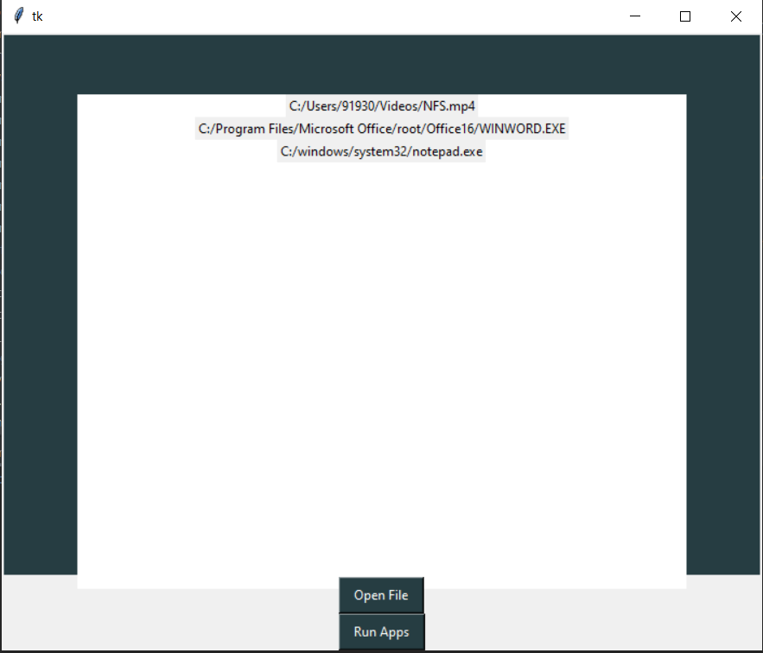
EXAMPLE OUTPUT

Slide 7
TKINTER
IT COMES WITH ALL THE MODULE DEFINED IN TKINTER
HOWEVER TO SAVE THE MAJOR TYPING EFFORTS WE IMPORT THE TKINTER LIBRARY WITH ACRONYM FURTHER THAT CAN BE USED TO CREATE A INSISTANCE OF WIDGETS
IT IS A GUI TOOLKIT

Slide 8
filediaog
import the filedialog module from Tkinter.
The File dialog module will help you open, save files or directories.
In order to open a file explorer, we have to use the method, askopenfilename().

Slide 9
OS modul
The OS module in Python provides functions for interacting with the operating system.
This module provides a portable way of using operating system-dependent functionality.
The *os* and *os.path* modules include many functions to interact with the file system.
OS functions for creating and removing a directory (folder)

Slide 10
PROJECT BY
DASHARATH AREKAR [19UET002]
PARTH KADAM [19UET015]
ATHARV ASAWALE [19UET004]

Slide 11
THANK YOU
……………………………………………………………………...

